Slide 1
Lesson #4
Reinforcing Knowledge Gained
How to adapt knowledge to solve a different problem
Burglar Alarm has all the components of Lessons 1 - 3

Slide 2
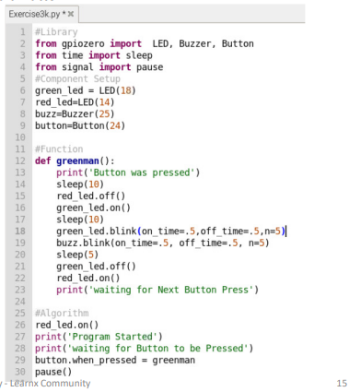
from gpiozero import Button
…….
…….
button.when_pressed = red_led.on
button.when_pressed = buzz.on
button.when_pressed = greenman
functions
from gpiozero import MotionSensor
motion_detector=MotionSensor(4)
…….
…….
motion_detector.when_pressed = red_led.on
motion_detector.when_pressed = buzz.on
motion_detector.when_pressed = alarm

Slide 3
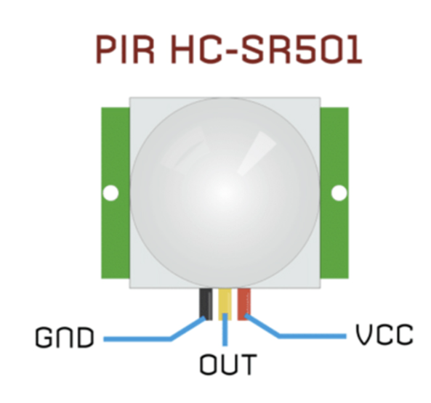
PIR – PASSIVE INFRA-RED MOTION SENSOR
-
+

Slide 4
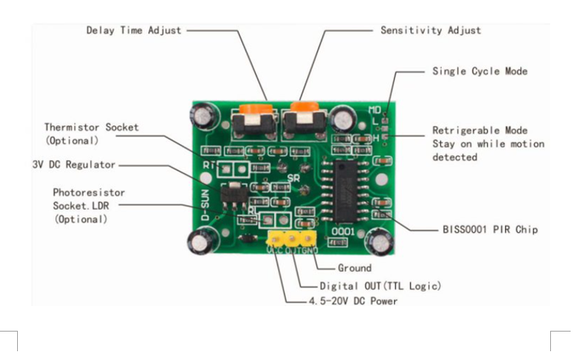
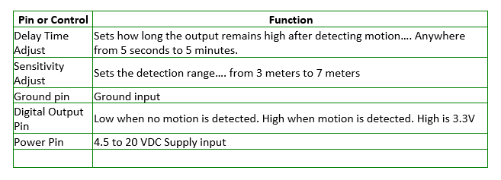

Slide 5
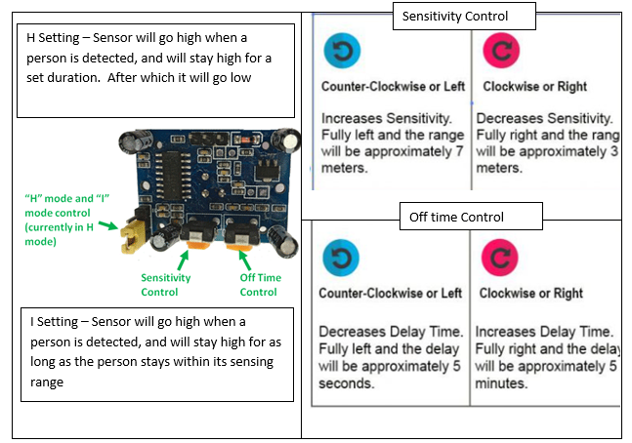

Slide 6
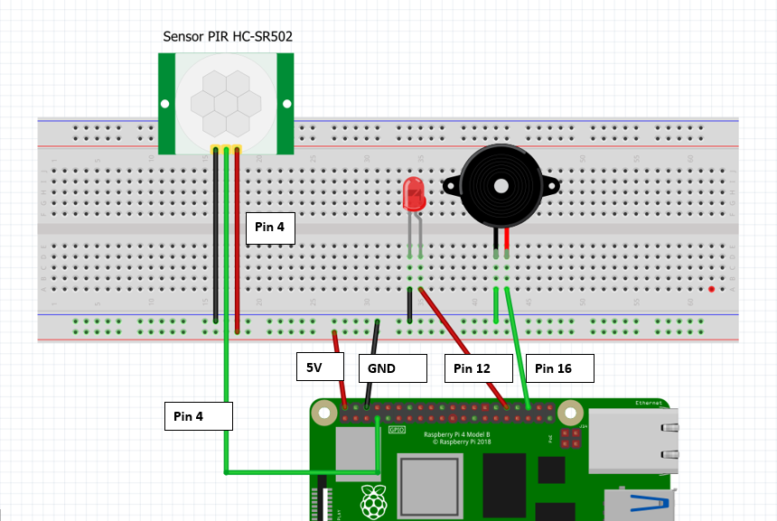
Exercise 4 Using Motion Sensor as a Burglar Alarm

Slide 7

Ex 4a. Motion Sensor – LED Test
Save this as Exercise4a.py
#Libraries
from gpiozero import MotionSensor, LED, Buzzer
from signal import pause
from time import sleep
#Setup Variables for Components
motion_detector = MotionSensor(4)
red_led = LED(12)
buzz = Buzzer(16)
buzz.off()
#Algorithm
motion_detector.when_motion= red_led.on
motion_detector.when_no_motion = red_led.off
pause
Ex 4b. Motion Sensor – Buzzer Test
Save this as Exercise4b.py
#Libraries
from gpiozero import MotionSensor, LED, Buzzer
from signal import pause
from time import sleep
#Setup Variables for Componenst
motion_detector = MotionSensor(4)
red_led = LED(12)
buzz = Buzzer(16)
#Algorithm
buzz.off()
motion_detector.when_motion= buzz.on
motion_detector.when_no_motion = buzz.off
pause
What if we want the red LED to blink and the Buzzer to sound at the same time when motion is detected?
pause()
pause()

Slide 8
Ex4c Motion Sensor – FLASHING LED AND BUZZER
Save program as Exercise4c.py
#Libraries
from gpiozero import MotionSensor, LED, Buzzer
from signal import pause
from time import sleep
#Setup Components / Variables
motion_detector = MotionSensor(4)
red_led = LED(12)
buzz = Buzzer(16)
buzz.off()
#Functions
def alarm():
buzz.blink(on_time=.5,off_time=.5,n=5)
red_led.blink(on_time=.5,off_time=.5,n=5)
sleep(5)
def alarmOff():
buzz.off()
red_led.off()
#Algorithm
motion_detector.when_motion= alarm
motion_detector.when_no_motion = alarmOff
pause

Slide 9
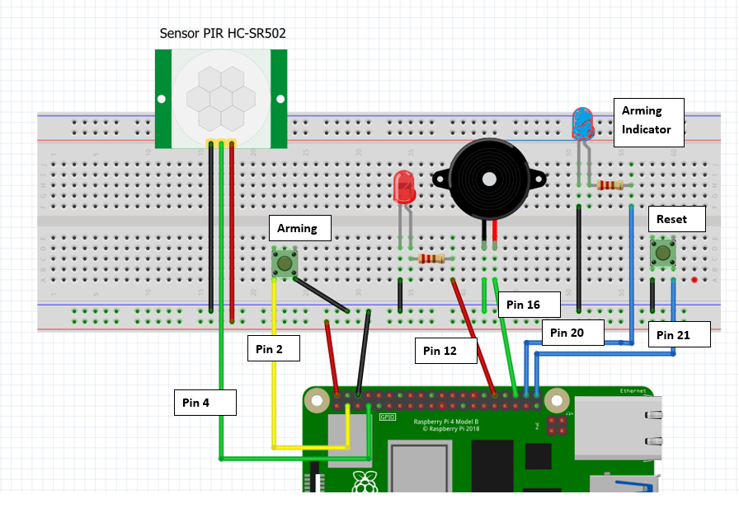

Exercise 5 Using Motion Sensor as a Burglar Alarm with Arm and Disarm Features
GND
VCC

Slide 10
Ex 5. BURGLAR ALARM WITH ARM AND RESET BUTTONS
#save this program as Exercise5.py
#Library
from gpiozero import MotionSensor, LED, Buzzer, Button
from signal import pause
from time import sleep
#Variables for Components
password=’12345’
motion_detector = MotionSensor(4)
red_led = LED(12)
armed_led=LED(20)
armed_led.off()
arm_button=Button(2)
reset_button=Button(21)
buzz = Buzzer(16)
buzz.off()
#Functions
def alarm():
red_led.blink(on_time=.5,off_time=.5,n=20)
buzz.blink(on_time=.5,off_time=.5,n=20)
sleep(20)
def armAlarm():
armed_led.on()
motion_detector.when_motion = alarm
def disarmAlarm():
pwd=input(‘Enter Password’)
if pwd != password:
pass
else:
armed_led.off()
buzz.off()
red_led.off()
motion_detector.when_motion = None
#Algorithm
arm_button.when_pressed = armAlarm
reset_button.when_pressed = disarmAlarm
while True:
pause()
DO Nothing

